Slide 1

XYZ Driver Association Case Study
Enterprise Systems Development

Slide 2
Group members
Fintan Kennedy – 14022421
Neptali Ortega-Gutierrez
Darren Stamper -
Lam Ninh – 17045580
Thao Ly - 18042472

Slide 3
Sprint 1 Deliverables
Project plan
Task delivery
Login function alongside connected database

Slide 4
Task identified – 1st sprint
Create a login page using jsp.
Link login page to the login servlet to check if entered details match the users entered details.
Create a class to handle login status with sessions.
If login is verified then mark user as logged in using the session handler
Identify tasks for the sprints and the who will be doing them.
Make sessions lasting 20 minutes

Slide 5
Tasks identified after 1st sprint
Create users table.
Create payments table.
Create members table.
Create claims’ table.
Create database access classes for users table.
Create database access classes for payments table.
Create database access classes for members table.
Create database access classes for claims table.
Create a user login page jsp file.
Add registration to login page.
Create a dashboard page for members user
Create a view for admin to see daily activities.

Slide 6
Gantt charts

Slide 7
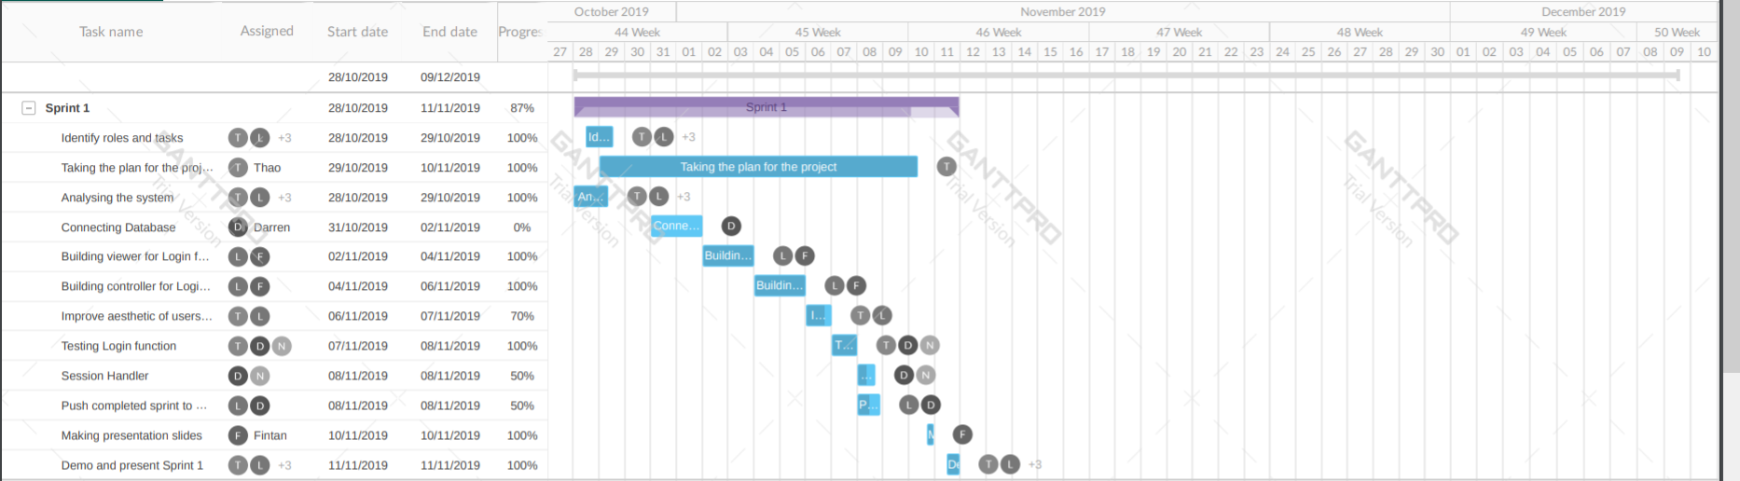
Sprint 1

Slide 8
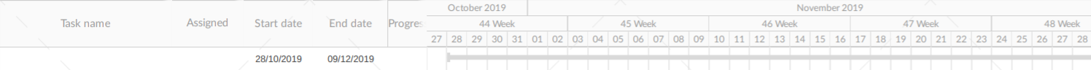
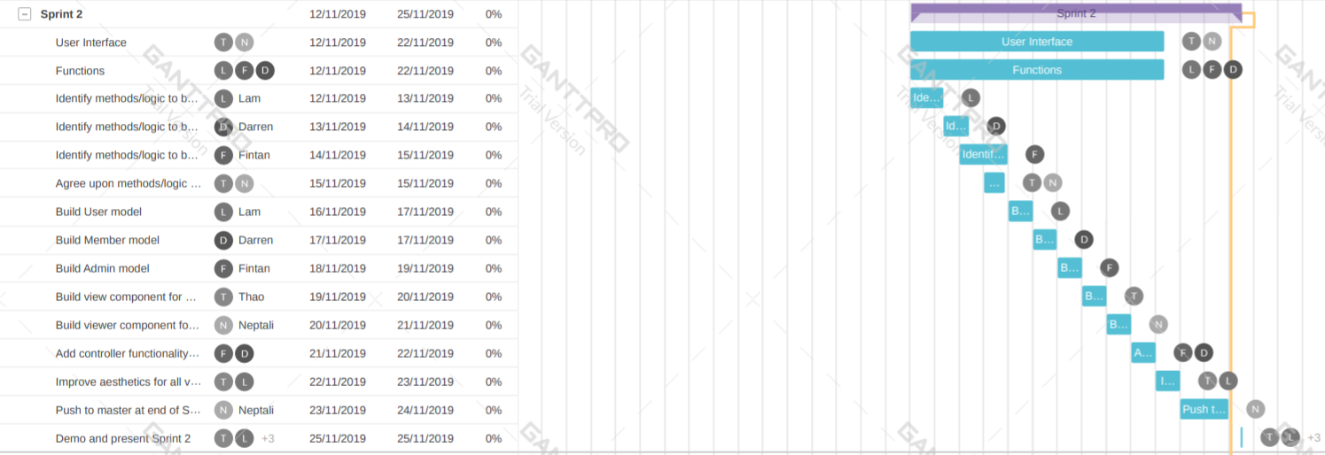
Sprint 2

Slide 9
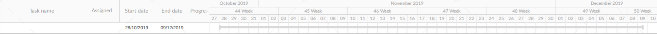
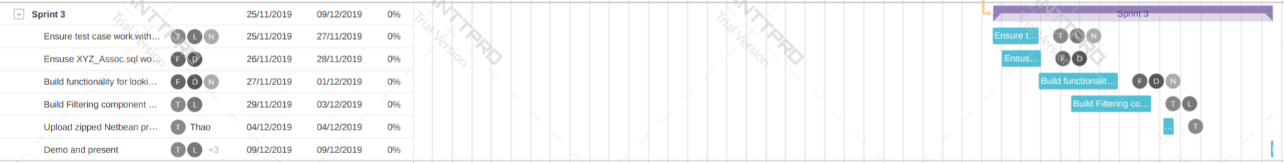
Sprint 3

Slide 10
Task Delivery Form
T1. Identify roles and tasks.
T2. Design Gannt chart.
T3. Analysing the system
T4. Make sure database is connected
T5. Build viewer for login function
T6. Build controller for login function
T7. Improve aesthetic for user.jsp
T8. Test Login function
T9: Session handler
T10. Push completed sprint to master branch
T11. Making presentation slides
 | Tasks
Group Members | T₁ | T₂ | T₃ | T₄ | T₅ | T₆ | T₇ | T₈ | T₉ | T₁₀ | T₁₁ | Signature
Fintan Kennedy | √ |  | √ |  | √ | √ |  |  |  |  | √
Neptali Ortega-Gutierrez | √ |  | √ |  |  |  |  | √ | √
Darren Stamper | √ |  | √ | √ |  |  |  | √ | √ | √
Lam Ninh | √ |  | √ |  | √ | √ | √ |  |  | √
Thao Ly | √ | √ | √ |  |  |  | √ | √
Status of Completion (%) | 100 | 100 | 0 | 100 | 100 | 100 | 70 | 100 | 50 | 50 | 100

